Slide 1
Integration of graph neural networks and genome-scale metabolic models for predicting gene essentiality
Ramin Hasibi,Tom Michoel and Diego A. Oyarzún
NPJ Systems Biology and Applications 2024
Presented by Xin-Shuang Zhang

Slide 2








Authors
Ramin Hasibi
PhD student, University of Bergen
Tom Michoel
Professor,
University of Bergen
supervise
Diego Oyarzún
University of Edinburgh
Integration of graph neural networks and genome-scale metabolic models for predicting gene essentiality

Slide 3
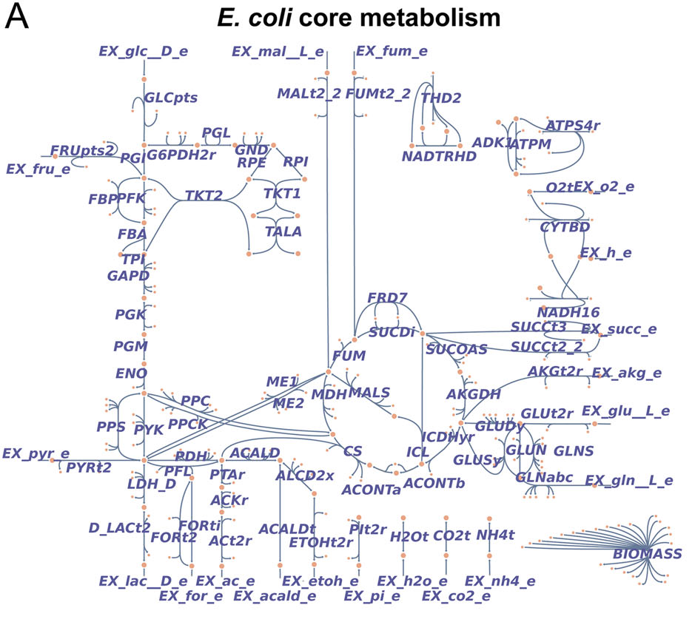
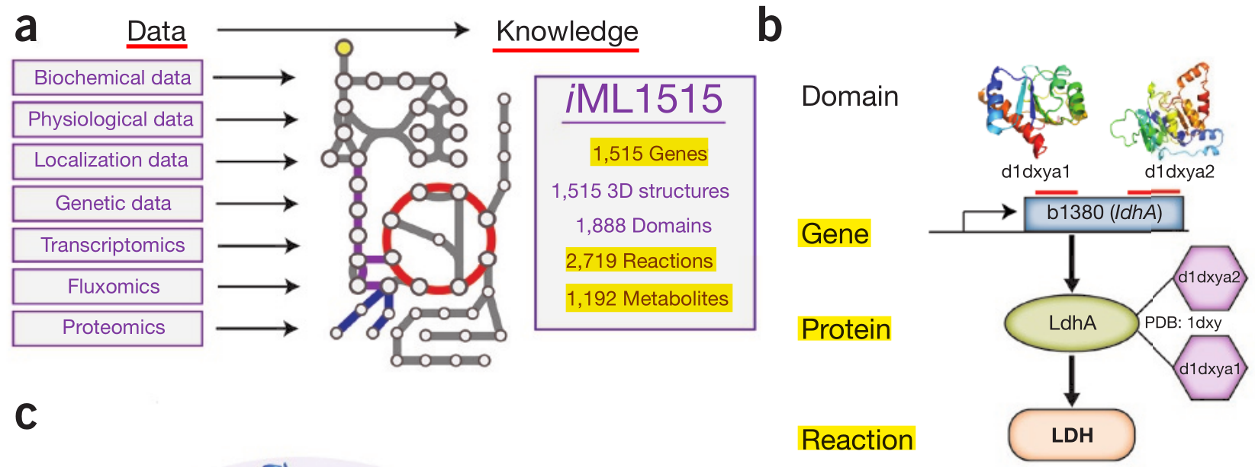
Genome-scale Metabolic Network
Identification of essential genes: How to know what genes that impair survival when deleted in the model?
Integration of graph neural networks and genome-scale metabolic models for predicting gene essentiality

Slide 4



Section 1
Flux Balance Analysis
Integration of graph neural networks and genome-scale metabolic models for predicting gene essentiality

Slide 5
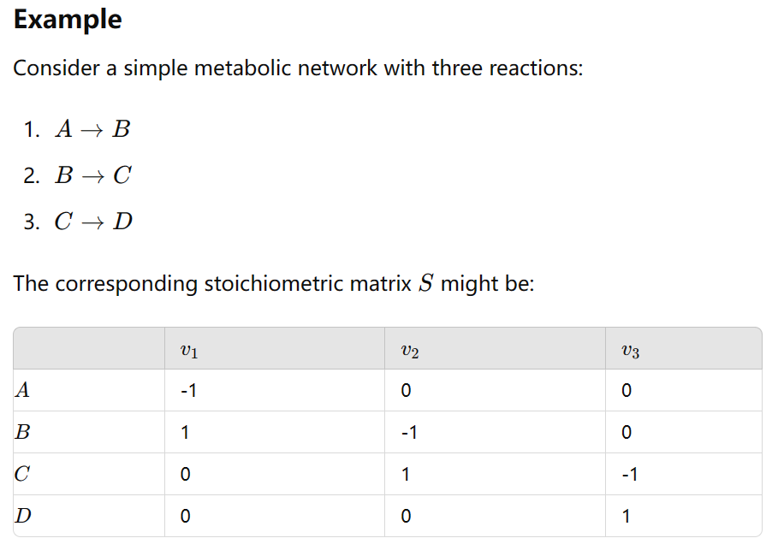
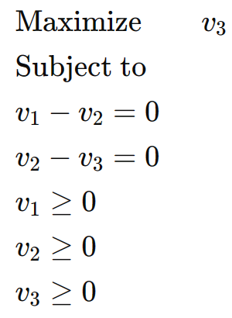
Flux Balance Analysis (FBAs)
Flux (v): The rate at which a metabolic reaction occurs, usually measured in terms of the amount of substrate converted or product formed per unit time.
Linear Programming
Biomass ?
Steady state ?
Negative Flux ?
objective function: maximize the production rate of D
Formulation
Flux Balance Analysis (FBAs)

Slide 6
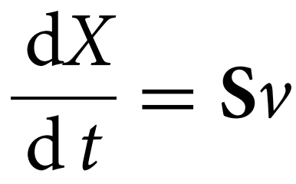
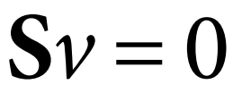

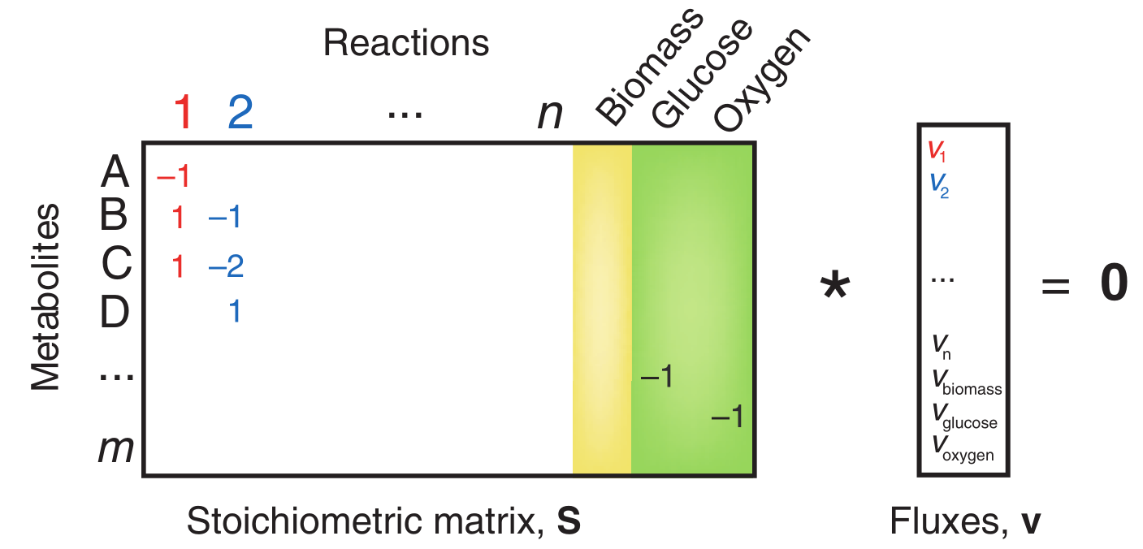
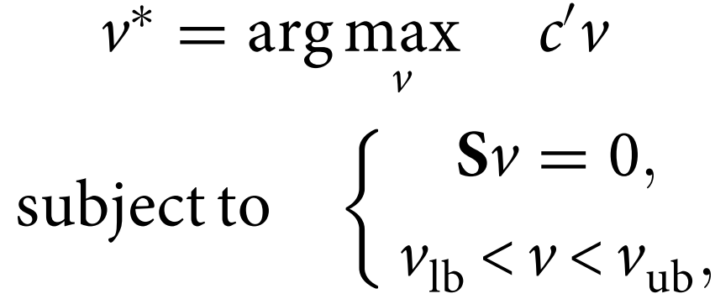
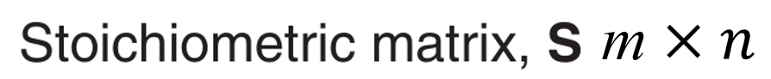
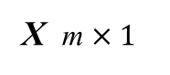
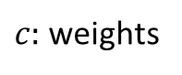
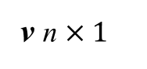
Flux Balance Analysis (FBAs)
We consider metabolic networks with m metabolites and n enzymatic reactions described by the following differential equation model:
Metabolite concentrations,
In steady state
Optimal Constraints
X m $×1$
$c:$weights
m
Reactions
m
lower and upper bounds
m
m
v n $×1$
Flux Balance Analysis (FBAs)

Slide 7
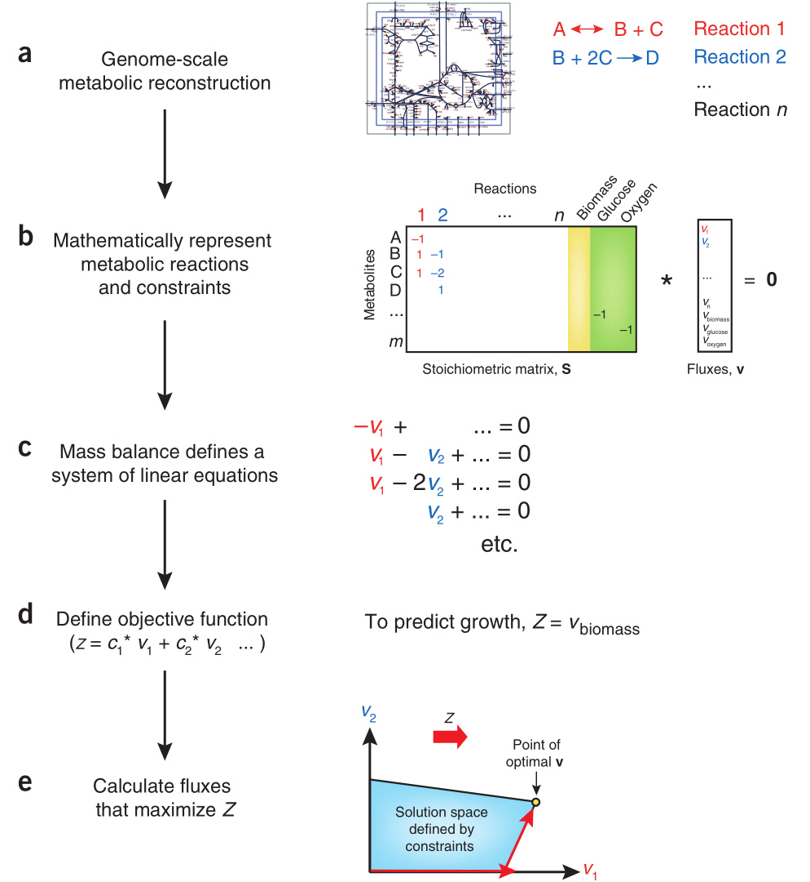
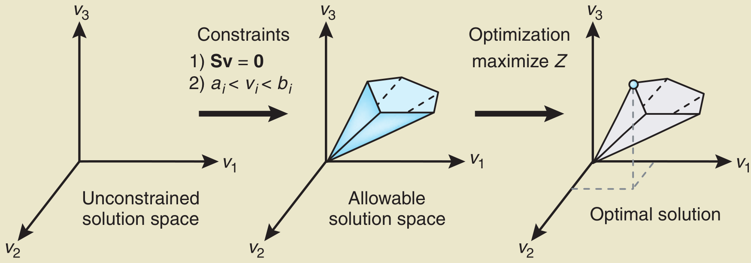
Flux Balance Analysis (FBAs)
Formulation of an FBA problem
FBA can rapidly simulate the impact of gene deletions on the predicted growth rate and draw predictions on the essentiality of metabolic genes.
Input: stoichiometric matrix, objective function, constrains
Output: genome-scale flux distribution
Flux Balance Analysis (FBAs)
Notes:
Such objective is typically taken to be the cellular growth rate modeled as a linear combination of synthesis rates of amino acids, lipids and other biomass components.

Slide 8
Motivation
FBA approaches additionally assume that deletion strains optimize the same objective as the wild type.
This paper present FlowGAT, a hybrid FBA-machine learning strategy for predicting essentiality directly from wild type metabolic phenotypes.
Start from wild type FBA solutions
Represent genome-scale flux distributions as a weighted directed graph
employ a flow-based representation for each node
employ a Graph Neural Network with an attention mechanism
Integration of graph neural networks and genome-scale metabolic models for predicting gene essentiality

Slide 9
Section 2
Graph construction
Integration of graph neural networks and genome-scale metabolic models for predicting gene essentiality

Slide 10
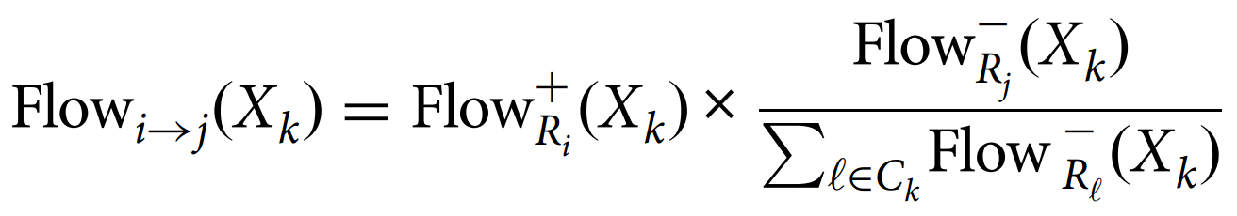
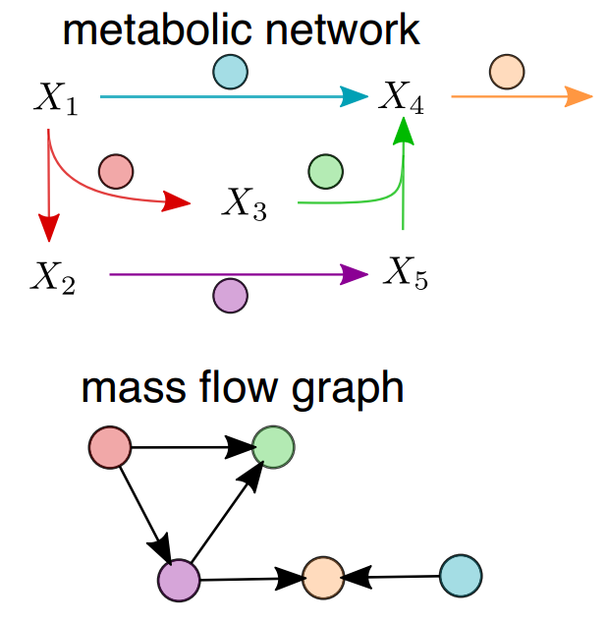
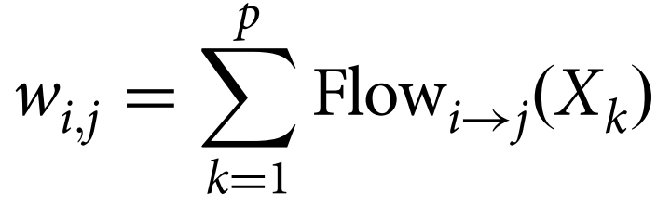
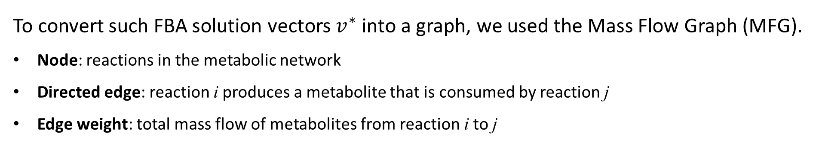
Mass Flow Graphs (MFGs)
To convert such FBA solution vectors $v^{∗}$ into a graph, we used the Mass Flow Graph (MFG).
Node: reactions in the metabolic network
Directed edge: reaction i produces a metabolite that is consumed by reaction j
Edge weight: total mass flow of metabolites from reaction i to j
Finally, the adjacency matrix $A{(v}^{∗})$ of the MFG can be calculated.
Graph construction

Slide 11
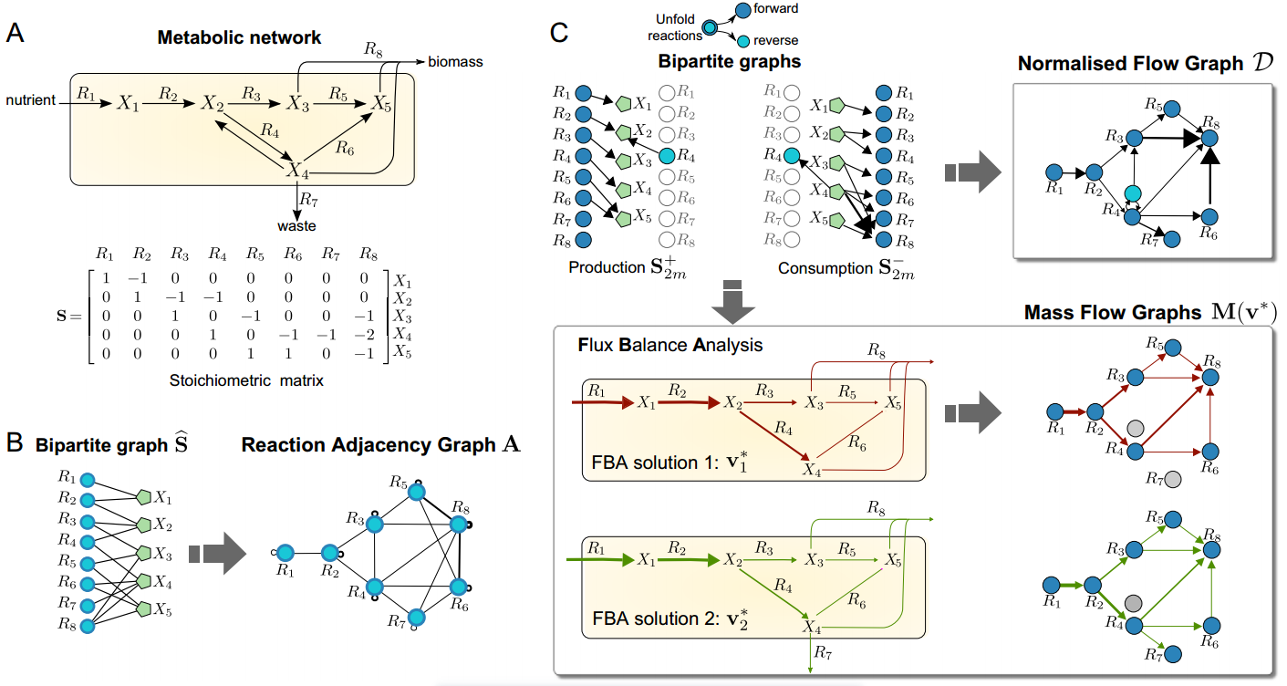
Mass Flow Graphs (MFGs)
Graph construction

Slide 12
Section 3
Graph Neural Network
Integration of graph neural networks and genome-scale metabolic models for predicting gene essentiality

Slide 13
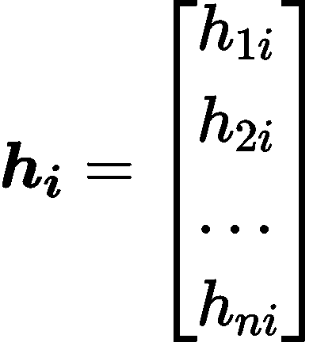
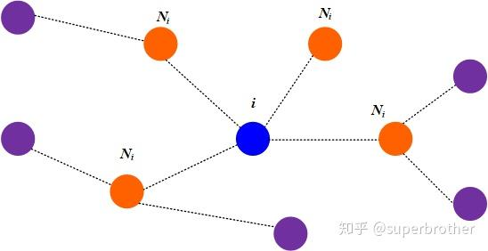
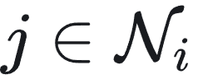
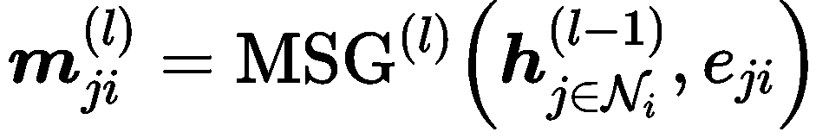
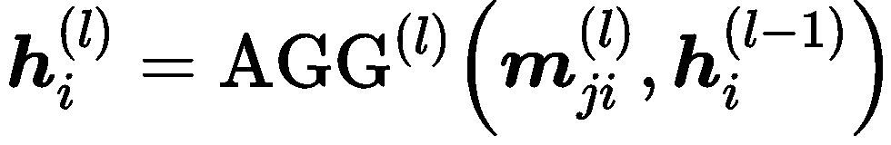
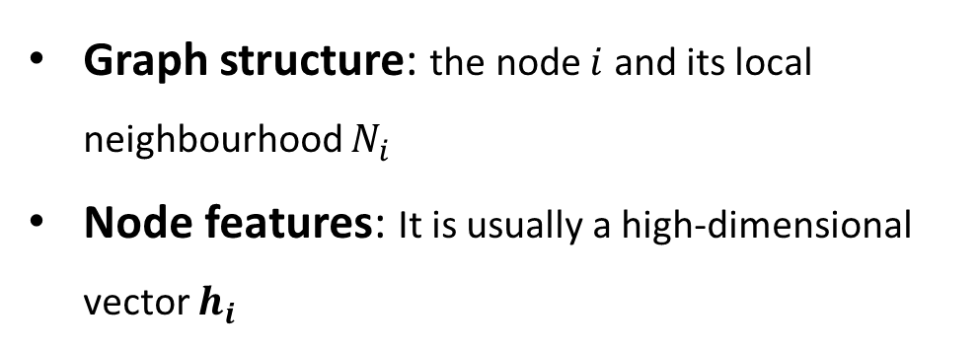
Graph Neural Networks (GNNs)
There is some information that are used in Graph Neural Networks (GNNs):
Graph structure: the node $i$ and its local neighbourhood $N_{i}$
Node features: It is usually a high-dimensional vector $h_{i}$
There are two steps of graph representation learning in layer (l) :
Message pass :
Message aggregate:
Graph Neural Network

Slide 14
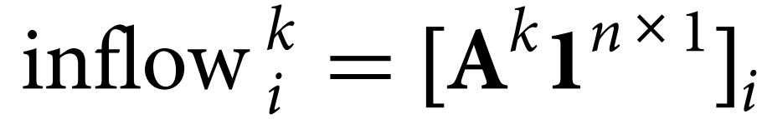
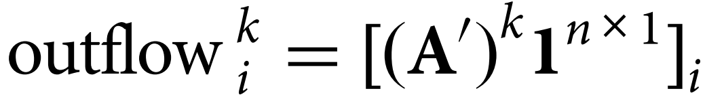
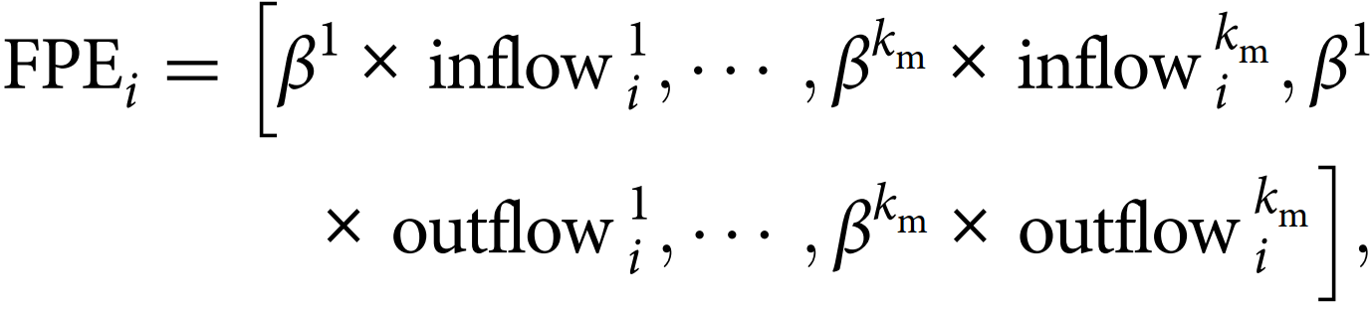
Flow Profile Encoding (FPE)
Given a directed graph with n nodes and weighted adjacency matrix A, for each node i we define the flow profile of length k as:
We concatenate inflows and outflows up to maximal length $k_{m}$ for each node:
This definition allows computing a feature vector of length $2k_{m}$ for each node in the graph.
Graph Neural Network

Slide 15
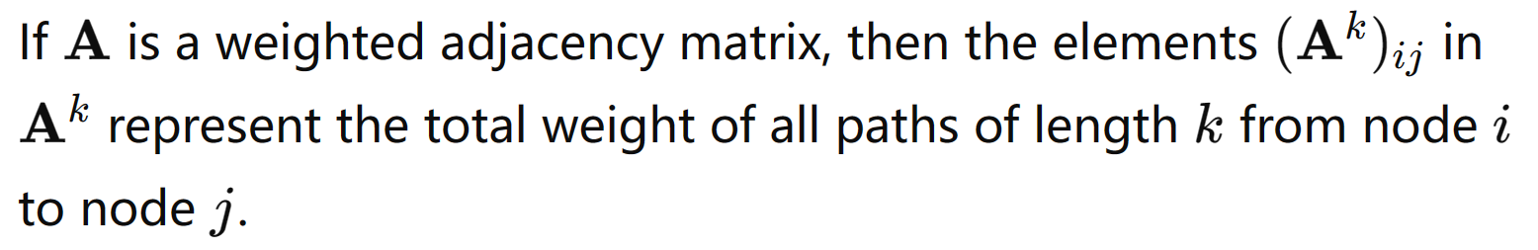
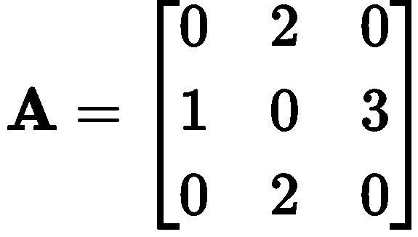
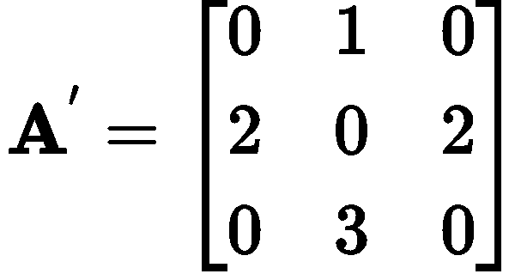
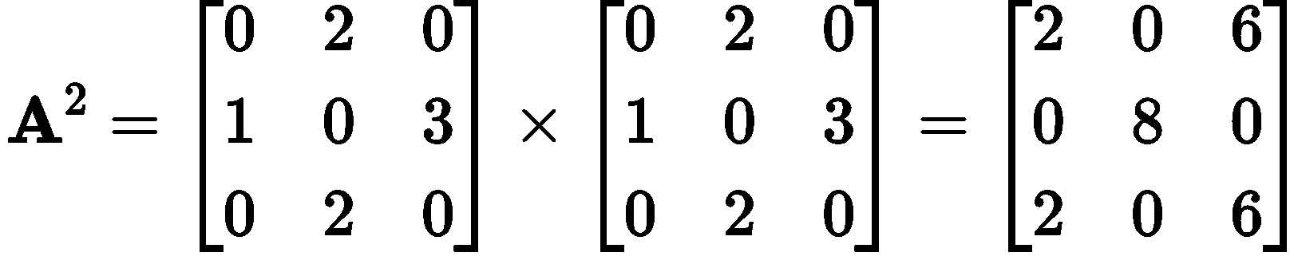
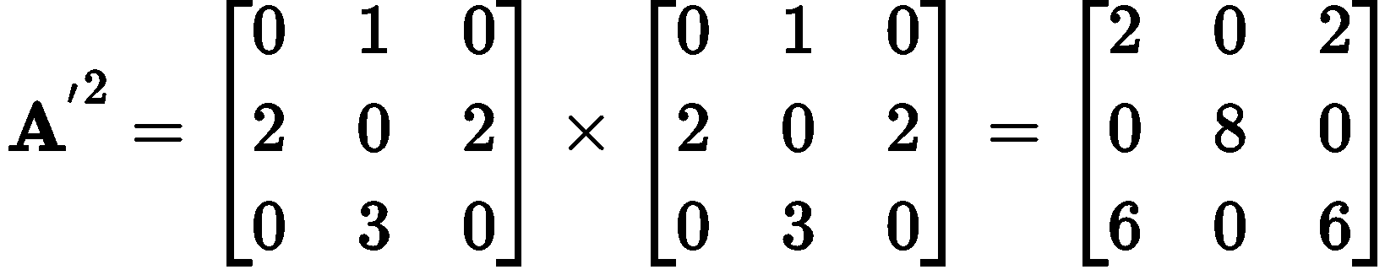
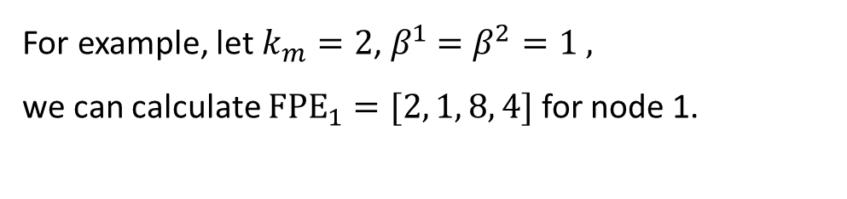
Flow Profile Encoding (FPE)
1
2
1
2
3
2
3
For example, let $k_{m}=2$, $β^{1}$ $=β^{2}=1 ,$
we can calculate ${FPE}_{1}=[2, 1, 8, 4]$ for node 1.
Graph Neural Network

Slide 16
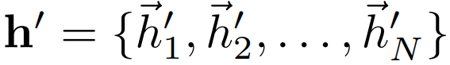
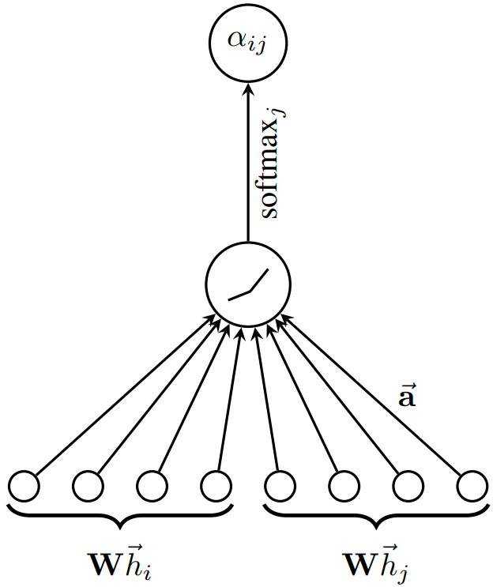
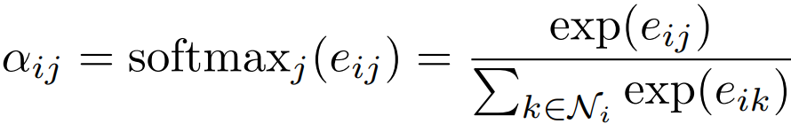
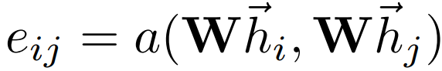
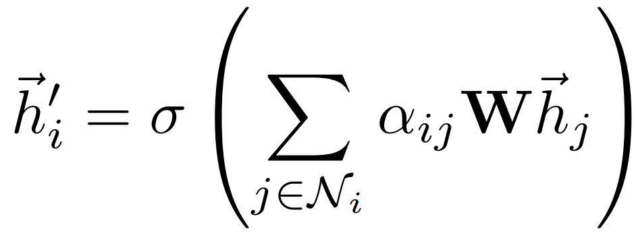
Graph Attention Network (GAT)
Graph Attentional Layer
1. Compute Attention Coefficient:
2. Feature Gggregation:
Graph Neural Network

Slide 17
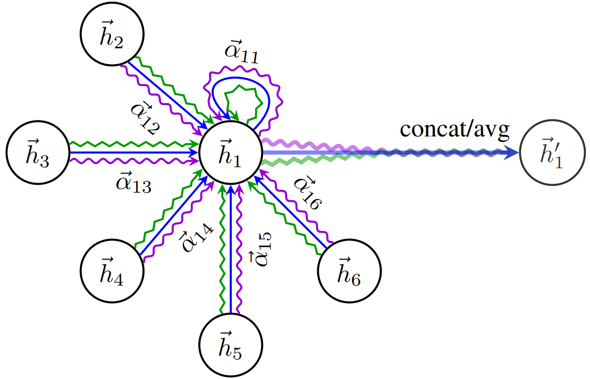
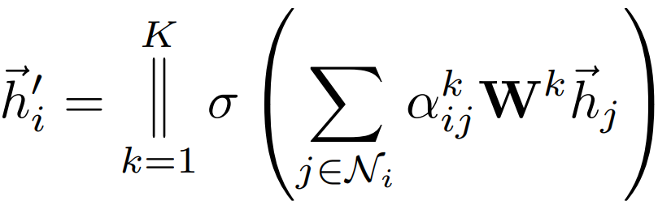
Graph Attention Network (GAT)
Multi-head attention:
Graph Neural Network

Slide 18
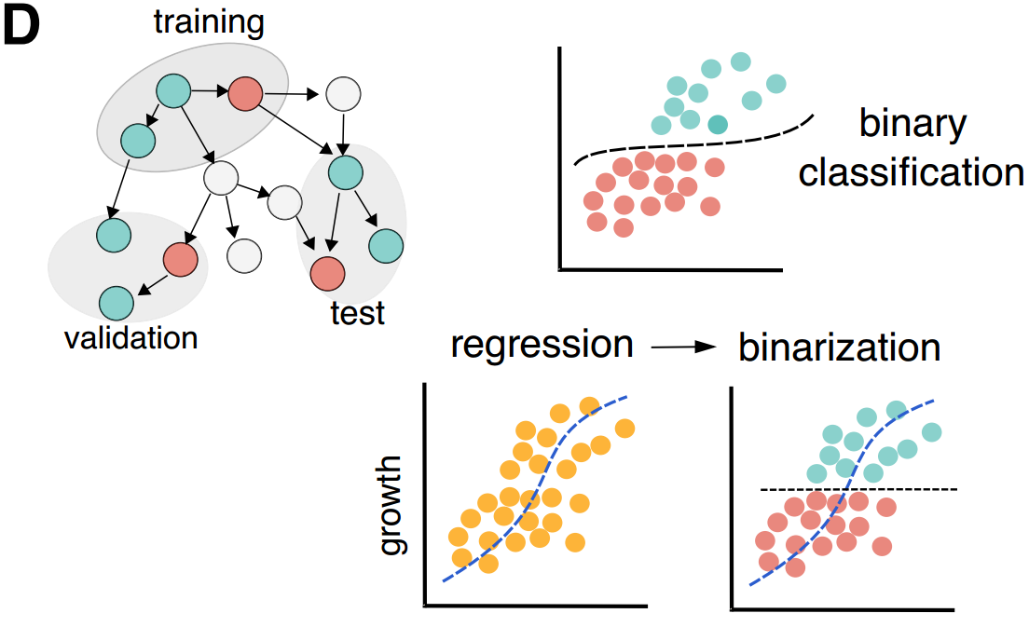
Data Pre-processing
Knock-out growth assay data: Each gene is labelled as non-essential (0) or essential (1) depending on whether a fitness score is above or below prescribed threshold.
Gene-Protein-Reaction (GPR) map: For model training, the binary gene labels must be converted into their corresponding reaction node labels. Why ?
One-to-one (labeled)
Many-to-one (labeled)
Many-to-many (unlabeled)
Genes have not been measured (unlabeled)
During training, the model has access to the features of all nodes through the message passing, but the training loss is calculated on the labeled nodes in semi-supervised fashion.
Graph Neural Network

Slide 19
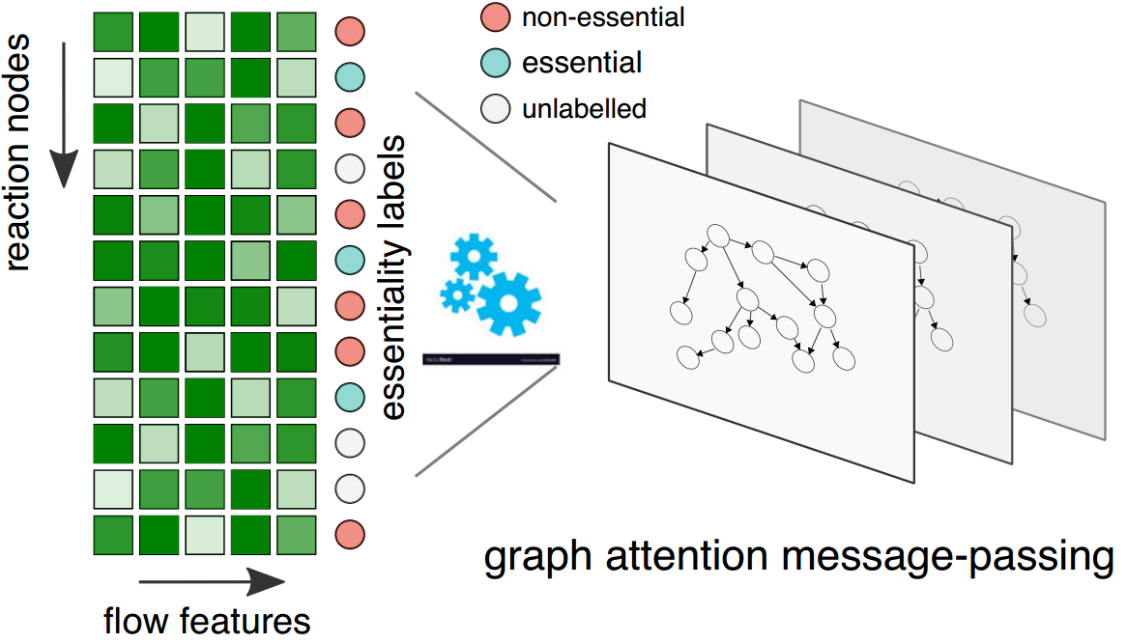
FlowGAT model
In a GNN node classification task, the input data consists of a node feature matrix, an adjacency matrix, and node labels. Using these inputs, the GNN can learn to represent the nodes' features and predict the classes of the unlabeled nodes.
Genome-scale Metabolic Network
Mass Flow Graph
Graph Attention
node classification
gene essentiality prediction
FBA
GPR map
Knock-out growth assay data
Pre-processing
Graph Neural Network

Slide 20
Section 3
Performance Evaluation
Integration of graph neural networks and genome-scale metabolic models for predicting gene essentiality

Slide 21
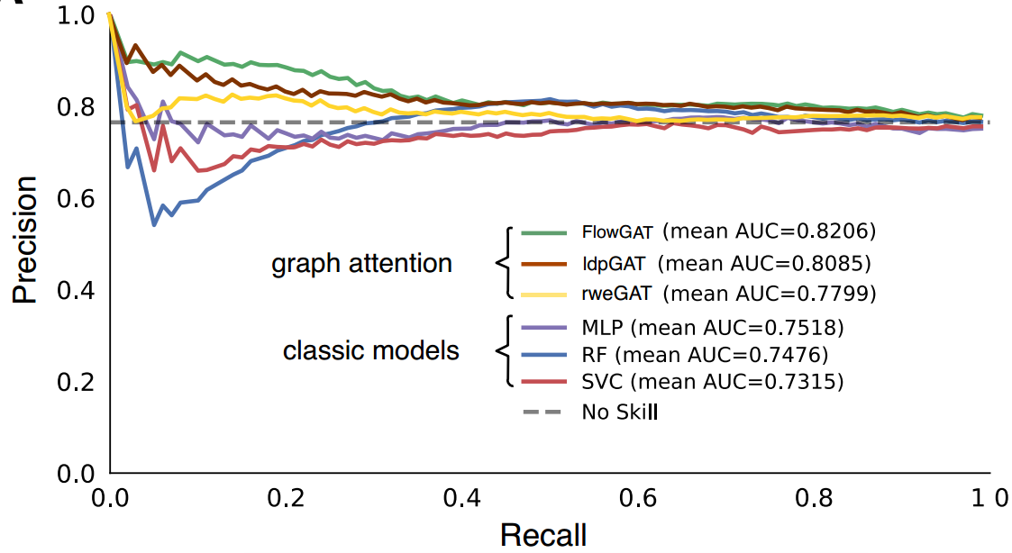
Experiment: Node Classification
This paper built the MFG for E. coli using the wild type FBA solution with glucose as the sole carbon source and the default objective function included in the iML1515 model (growth rate).
The resulting MFG has 444 nodes, including 255 labeled nodes (191 essential and 64 nonessential).
Compare FlowGAT trained on cross-entropy loss with classical binary classifiers

Slide 22
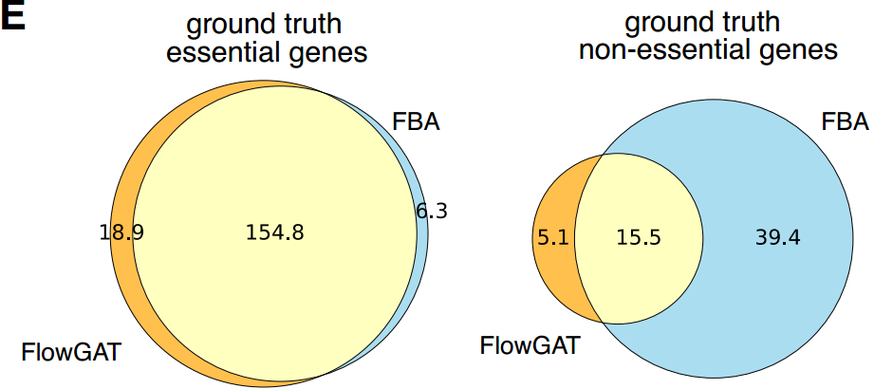
Comparison between FlowGAT and FBA
Venn diagrams show the number of genes called correctly for each model, averaged across 10 rounds of retraining FlowGAT for different random seeds.
Performance Evaluation

